Slide 1
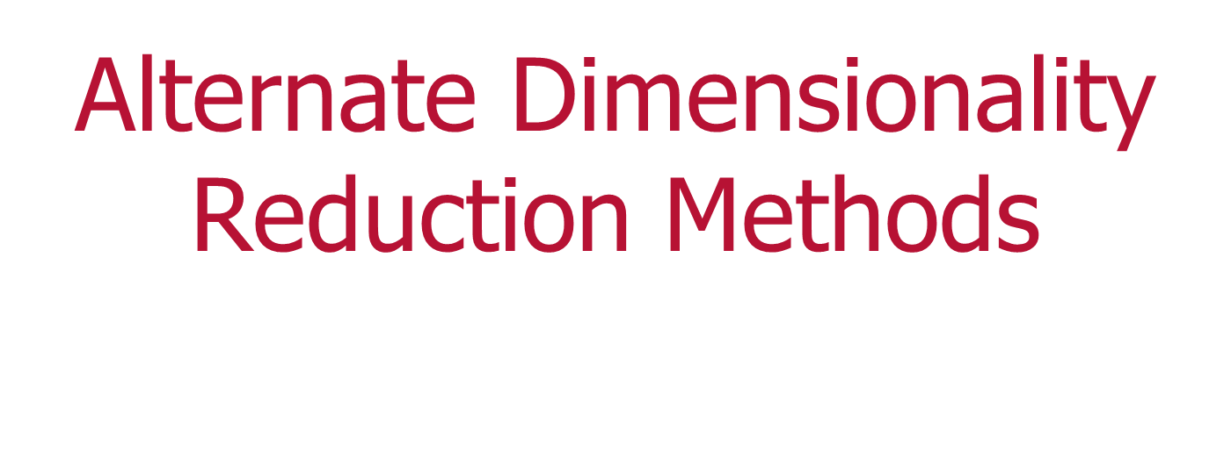
Andrew Treadway

Slide 2
What is dimensionality reduction?
Process of reducing the number of variables in a dataset
Feature selection
Filter methods (e.g. Information Gain / Gini Impurity)
Wrapper methods (e.g. Genetic Algorithm)
Feature extraction
PCA / ICA / RCA (Random Projections) / LDA

Slide 3
Why do dimensionality reduction?
Lower number of features is easier to handle
“Curse of Dimensionality”
Can help with overfitting
Reduces memory storage costs (e.g. image compression)

Slide 4
Maps a collection of variables to a set of uncorrelated features (principle components)
Goal is to reduce number of features without losing much information
The produced components are ordered such that the first component explains the most amount of variance in the data set, the second explains the second most etc.
The ordering by variance explanation allows potential reduction of features
Principle Component Analysis (PCA)

Slide 5
How does PCA work?
Calculate the covariance matrix of the dataset
Find the eigenvalues / eigenvectors of covariance matrix
Sort eigenvectors by eigenvalue (decreasing order)
The first eigenvector = first principle component (most variance), the second eigenvector = second principle component (second most amount of variance) and so on

Slide 6
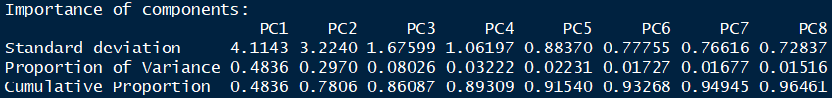
How does PCA work (cont.)?
Example:
Take dataset of stock prices with 35 technical features, including moving average, rate of change, RSI etc.
Reduce dataset to much smaller collection of PCs

Slide 7
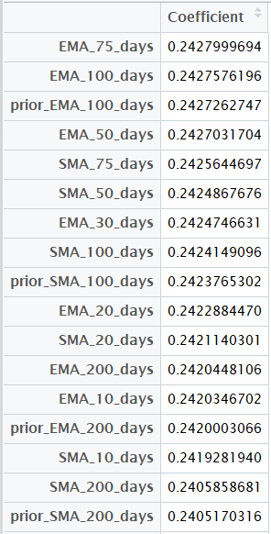
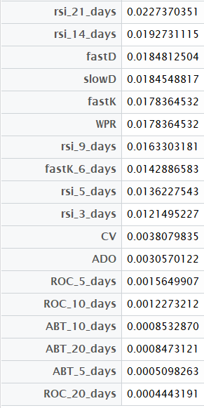
Interpreting Principle Components
The coefficients of each principle component explain what variables drive that component

Slide 8
PCA Implementations
R
prcomp, princomp functions
Python
Scikit-Learn (sklearn.decomposition)
Scala
MLlib

Slide 9
When does PCA fail?
Blind Source Separation!
Finding the independent features of images
Efficiency for large datasets

Slide 10
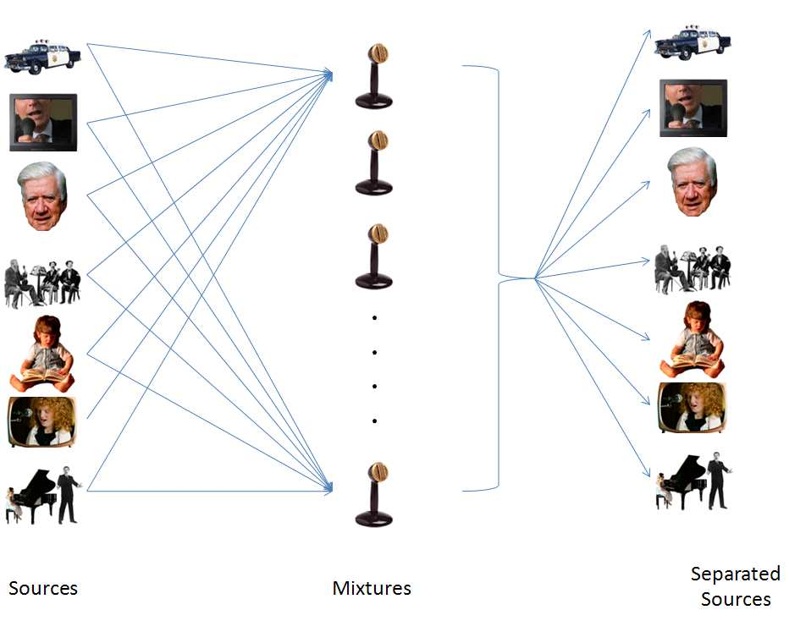
The Cocktail Party Problem
How to identify individual sources from dozens of sounds?

Slide 11
Independent Component Analysis (ICA)
Attempts to map a collection of variables to statistically independent features
In other words, ICA tries to find the independent sources comprising collections of variables, or signals
Applications include image recognition, topic modeling, and audio analysis

Slide 12
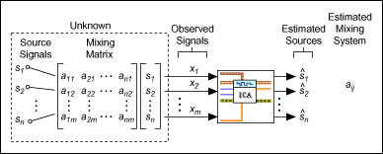
How does
ICA work?
X = A * s
s = Source signals / variables (what we’re trying to find)
A = “Mixture” matrix
X = What is observed / Dataset
Goal: Find the inverse of A, so we can solve for s.
Each initial feature can be expressed as x_{j} = a_{j1}s₁ + a_{j2}s₂ + … + a_{jn}s_{n}

Slide 13
How does ICA work (cont.)?
Whiten (sphere) the dataset
Get rid of any correlations
Apply orthogonal transformation to decorrelated features
Find weights, w, such that
w^{T} * x maximizes non-gaussianity
Optimal result finds collection of independent features (less than original number of variables)

Slide 14
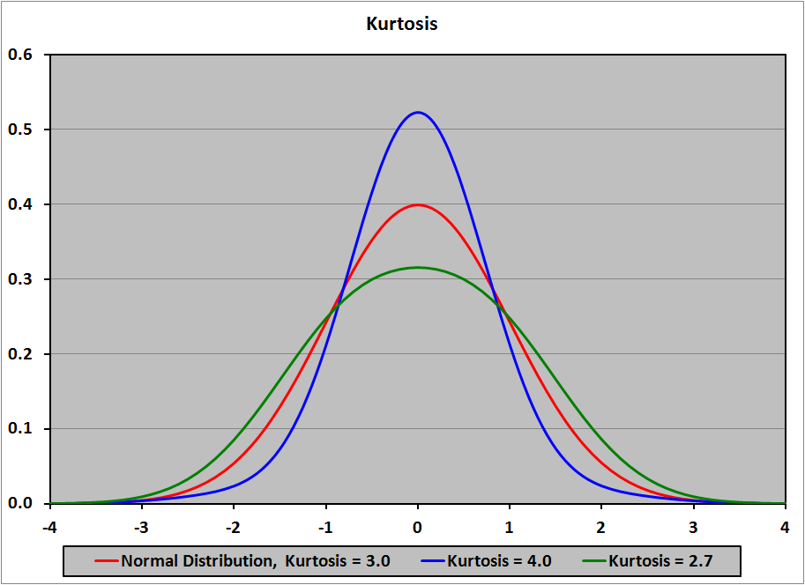
How many independent components?
A few possibilities exist
Non-gaussian variables are statistically independent – thus the number of ICs that maximizes non-gaussianity (e.g. kurtosis) is one
popular method

Slide 15
What are the independent components?
Varies by dataset
For images, ICA finds the underlying structure, or curves and edges of the images
For audio, ICA finds the individual sound sources (e.g. different voices)
For financial market data, may find independent drivers of the market (e.g. particular events, actions taken etc.)

Slide 16
ICA Implementations
R
ica package
Python
Scikit-Learn (sklearn.decomposition)
mdp package

Slide 17
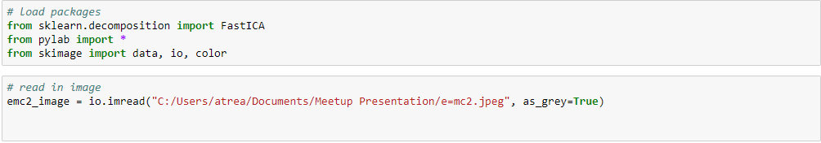
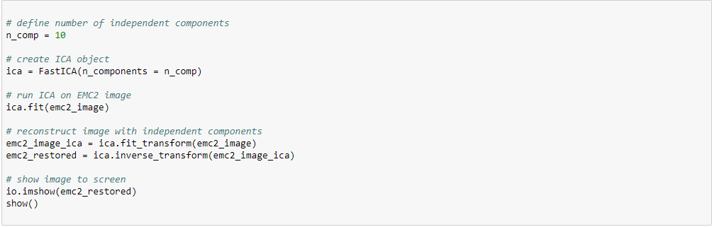
ICA Example: Image Recognition (with Python)

Slide 18
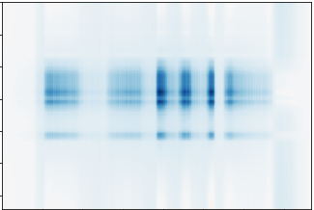
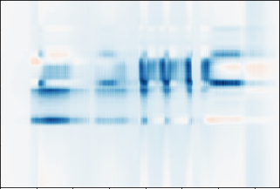
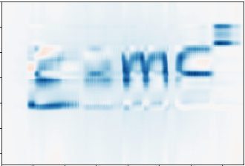
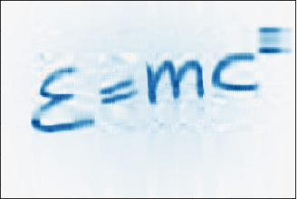


ICA Example: Image Recognition (cont.)
# Components = 1
# Components = 3
# Components = 5
# Components = 10
# Components = 20
Original Image

Slide 19
Randomized Component Analysis /
Random Projections (RCA)
Used for large datasets
Mathematically, RCA tries to solve the following equation:
X_{new} = R * X_{initial}
X_{initial} = initial dataset
R = generated matrix from some distribution (e.g. gaussian)
Goal is to find X_{new} with less features than X_{initial}

Slide 20
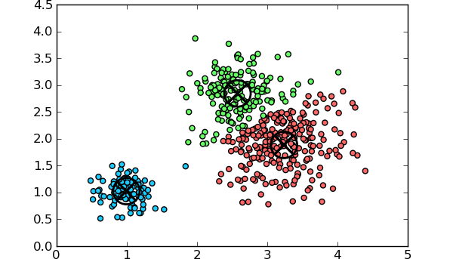
Clustering as
Dimensionality Reduction
What is clustering?
Grouping data points so that data points within each group are more similar to each other than to those in other groups
Types of clustering
K-means, Hierarchical, NMF (Non-negative Matrix Factorization) etc.

Slide 21
Example: Clustering for Image Compression
Motivation:
Each image stored in a computer consists of a collection of pixels
Each pixel is represented as a three-dimensional RGB vector, where each element in the vector has 256 possible values
256 x 256 x 256 = 2²⁴ possible values (or 24 bits) per pixel

Slide 22
Clustering for Image Compression (cont.)
How to save memory?
Map each pixel’s RGB vector to a cluster value
Example: Performing clustering on the pixels for 5 clusters would map each pixel to one of 5 possible values (3 bits), rather than 2²⁴
Tradeoff: Information loss vs. memory savings

Slide 23
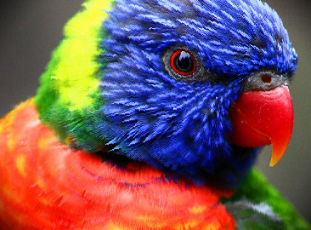


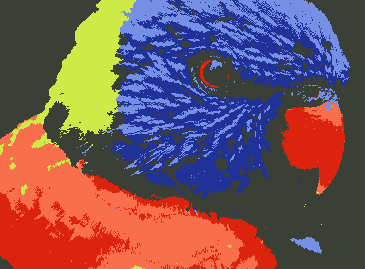
Original Image ➔
3 clusters
5 clusters
6 clusters

Slide 24
Non-Negative Matrix Factorization (NMF) Clustering
What is NMF clustering?
Uses matrix factorization to do clustering
Factor initial dataset, V, into matrices H and W
V = H * W, such that H and W are non-negative
Closely related to K-means, but allows for fuzzy clustering

Slide 25
NMF Clustering (cont.)
NMF works by finding a reduced matrix, or reduced set of features, such that the original data points can be expressed as linear combinations of this smaller set
In linear algebra terminology, NMF tries to find basis vectors for the original dataset, V
For the factorization, V = H * W,
H ➔ Provides cluster assignments
W ➔ Columns contain centroids of the clusters

Slide 26
NMF Clustering Applications
Several application areas:
Text mining / Topic Modeling
Computer Networking
Computer Vision

Slide 27
Packages for NMF
R
NMF
Python
Scikit-Learn (sklearn.decomposition)
Scala
Use “breeze” package to build from scratch

Slide 28
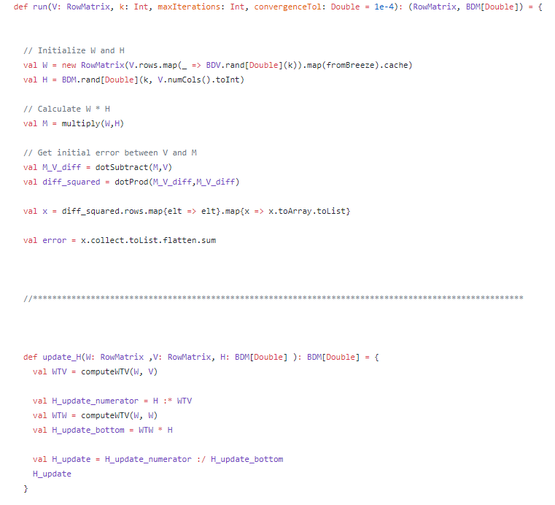
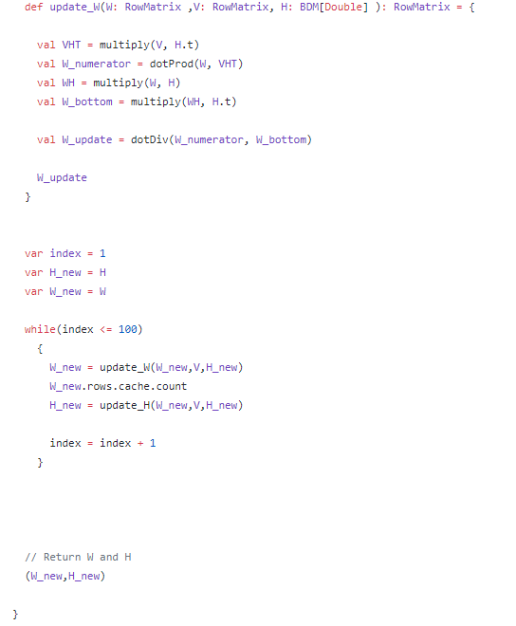
NMF From Scratch

Slide 29
Combining Dimensionality Reduction Methods
Running PCA prior to clustering
Running ICA prior to clustering
Running PCA / ICA together to compare results for your dataset

Slide 30
Questions?

